Slide 1




A PowerBI Analysis For Columbia Asia Hospital
~Hrishik Verma~

Slide 2
Problem Statement
“ You have been hired as a consultant data analyst by Columbia Asia Hospital. The Hospital is looking for key insights for the following objectives:
Assess the hospital's revenue generation
Insights about suitable departments for new hires
Strategies suggestions for patient discounts
Your task is to perform data analysis and come up with a report in order to help the organization with the mentioned objectives. “

Slide 3
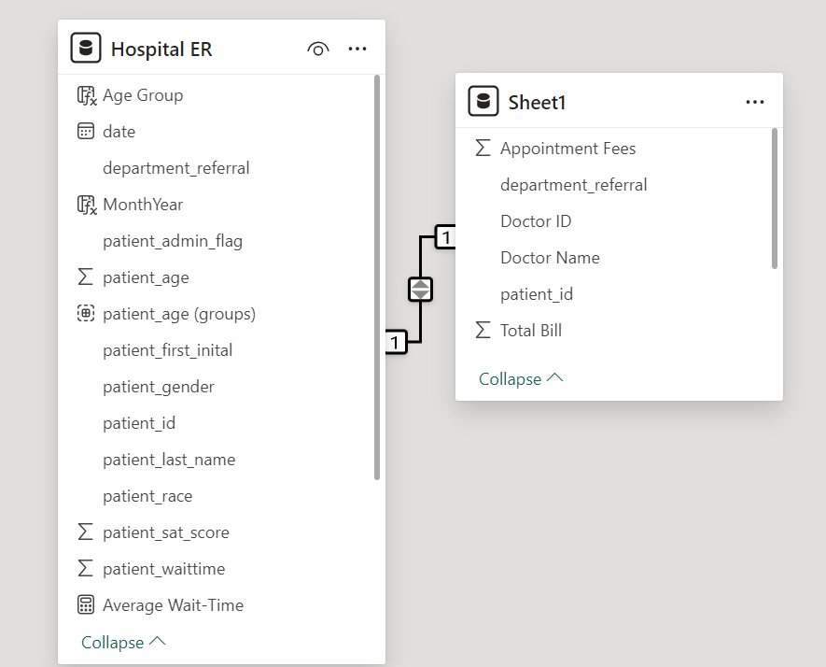
Overview Of The Dataset
No. of Tables: 2
9216 Rows in Table ‘Hospital ER’
9216 Rows in Table ‘Sheet1’
7 Departments [General, Orthopedics, Physiotherapy, Cardiology, Neurology, Gastroenterology, Renal]
7 Patient Race Categories [White, Black, Multiracial, Asian, Pacific Islander, Native American, Declined to Identify]

Slide 4
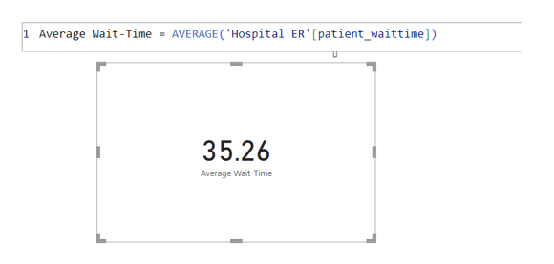
Objective Questions
Average Waiting Time [minutes] For A Patient

Slide 5
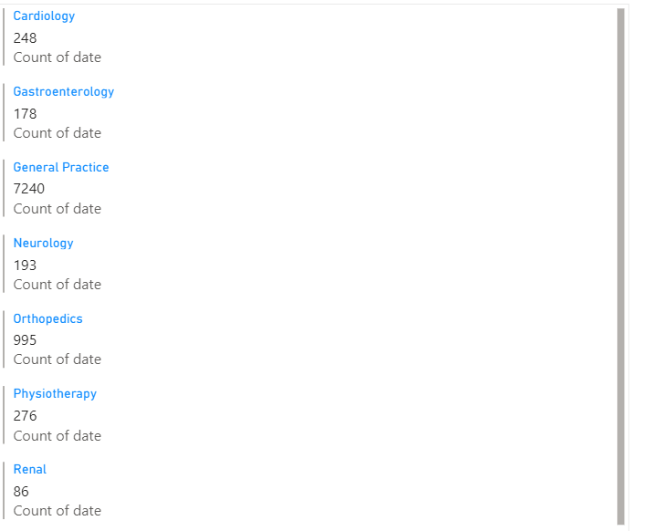
Objective Questions
Overall Count Of Visits To Each Department
As seen from the adjacent results, General Practice remains the most visited department followed by Orthopedics. Traffic to the other departments falls well behind these two, and Renal receives the least visitors.

Slide 6
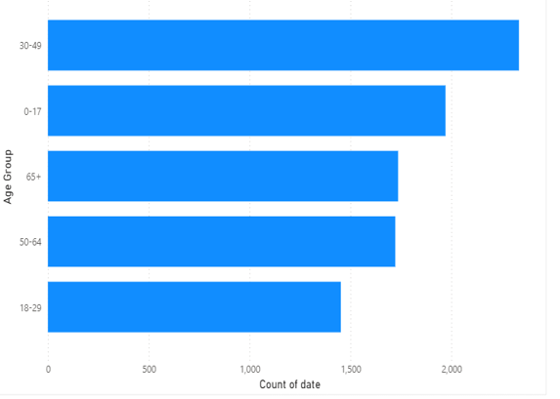
Objective Questions
Patients Split By Age Group
We find that the 30-49 age group [Millennials and younger Gen-Xers] is the most frequent patron of the Hospital, followed by infants & teenagers, and then by Geriatrics over 65. The latter group is closely matched by Middle-aged adults. Young adults, as expected, make the least visits.

Slide 7
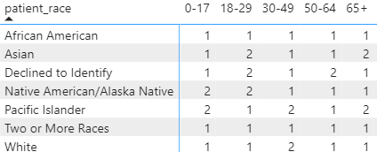
Objective Questions
Patient Satisfaction By Age & Race
Among younger patients [ages 0-29], Native Americans/Alaska Natives and Asians offer the most favorable ratings, while among those over 49, Pacific Islanders and Asians do so. The least satisfaction among the races is expressed by the African Americans, Biracials and Whites.

Slide 8
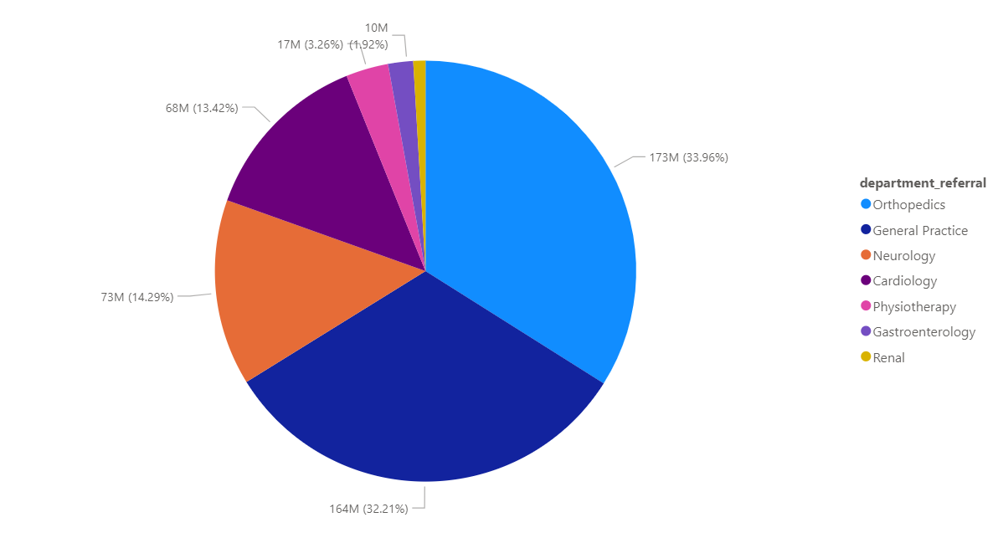
Objective Questions
Revenue, By Department
Orthopedics and General Practice bring in the most revenue, being the most visited departments. Against expectations, however, the former outgrosses the latter.
More strikingly, the Physiotherapy department generates far smaller revenue than Cardiology or Neurology despite both of these each receiving a comparable share of visitors.

Slide 9
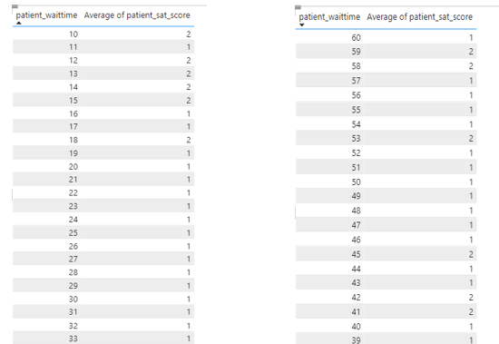
Insights & Recommendations
Waittime-Satisfaction Correlation
It is seen that a waiting time shorter than 20 minutes yields, on average, a higher satisfaction score.

Slide 10
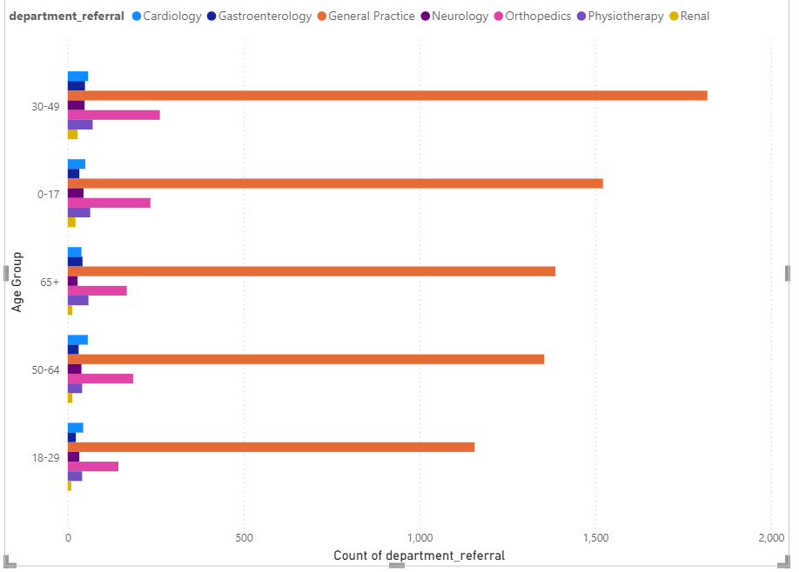
Insights & Recommendations
Correlation between demographic subcategories and Dept. visited
By Age:

Slide 11
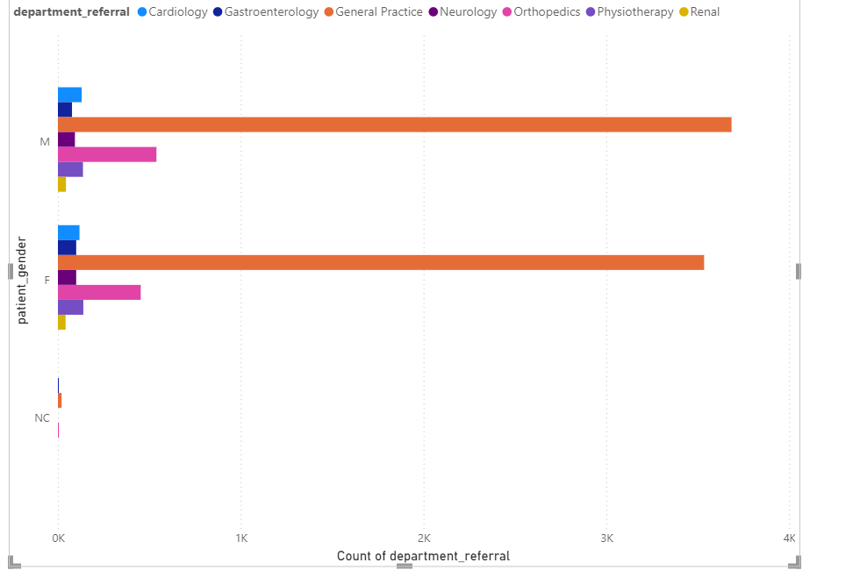
Insights & Recommendations
Correlation between demographic subcategories and Dept. visited [contd.]
By Gender:

Slide 12
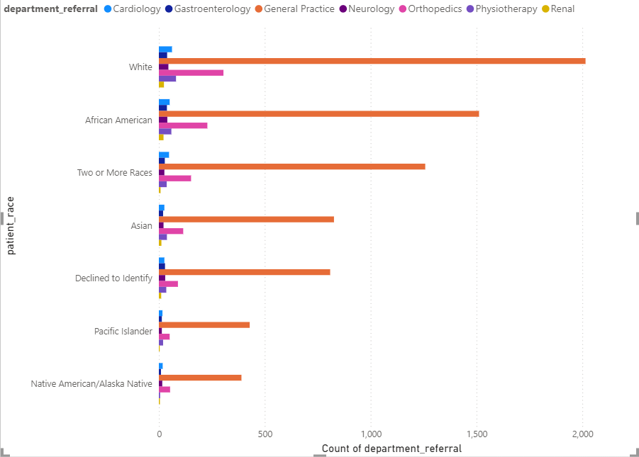
Insights & Recommendations
Correlation between demographic subcategories and Dept. visited [contd.]
By Race:

Slide 13
Insights & Recommendations
Correlation between demographic subcategories and Dept. visited [contd.]
Findings:-
General Practice and Orthopedics remain the two most visited departments regardless of age, gender and race.
Senior citizens make slightly more visits to Gastroenterology.
Males make more visits to Cardiology.
All race categories besides Whites, Afro-Americans and Multiracials make less-frequent visits in general.

Slide 14
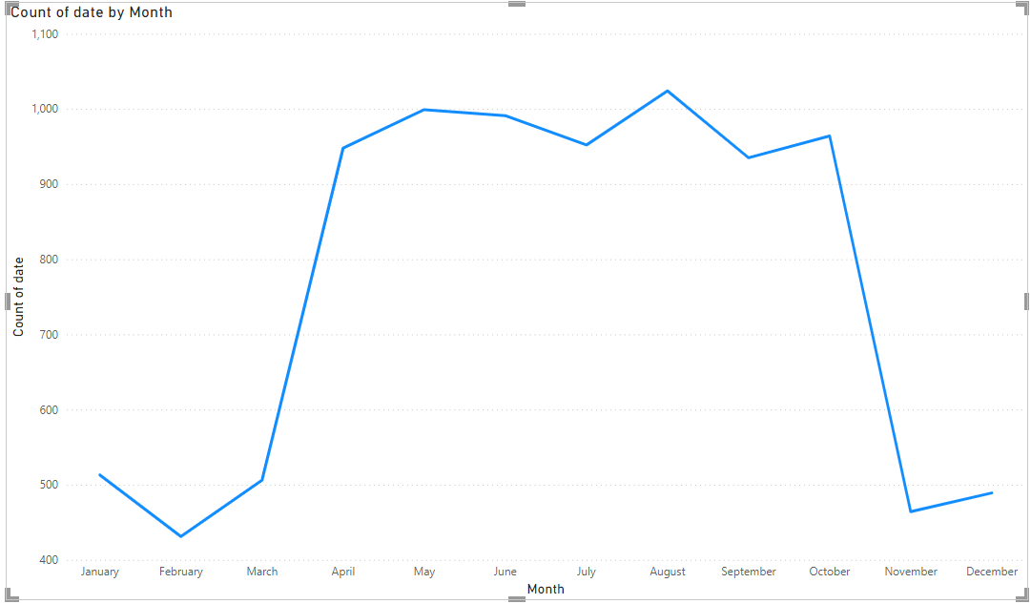
Insights & Recommendations
Tracking Volume Of Visits Annually
The busiest periods for the hospital begin from March onwards and continue relatively consistently till late October (minus a decline in July, possibly attributable to Independence Day holidays), peaking in mid-August.

Slide 15
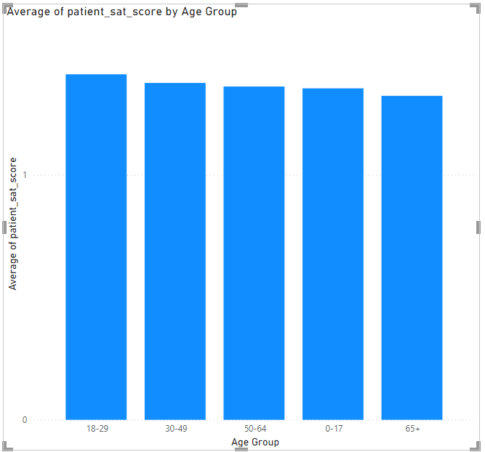
Insights & Recommendations
Age-Satisfaction Correlation
18-29 year-old patients report the highest scores (despite being the least frequent visitors) while those over 65 (the second most frequent visitors) report the lowest.

Slide 16
Insights & Recommendations
Proposed Discount Program Strategy
Based on Satisfaction Scores: Patients who have reported low satisfaction scores should be prioritized for discounts. Offering discounts to these patients can help improve their perception of the hospital and encourage them to return, potentially boosting their satisfaction in the future.
2. Based on Demographic Factors: Elderly patients, who often require more frequent visits and treatments, could be offered discounts to reduce their financial burden. Alternatively, young patients might be targeted with discounts to encourage early preventive care.

Slide 17
Insights & Recommendations
Proposed Discount Program Strategy [contd.]
3. Based on Frequency of Visits: Patients who visit frequently could be rewarded with discounts as a form of loyalty incentive. E.g., after a certain number of visits, a patient might receive a discount on their next visit.
4. Target High-Cost Departments: Patients who frequently visit departments associated with high costs (e.g., oncology, surgery) might benefit from discounts to reduce financial strain.

Slide 18
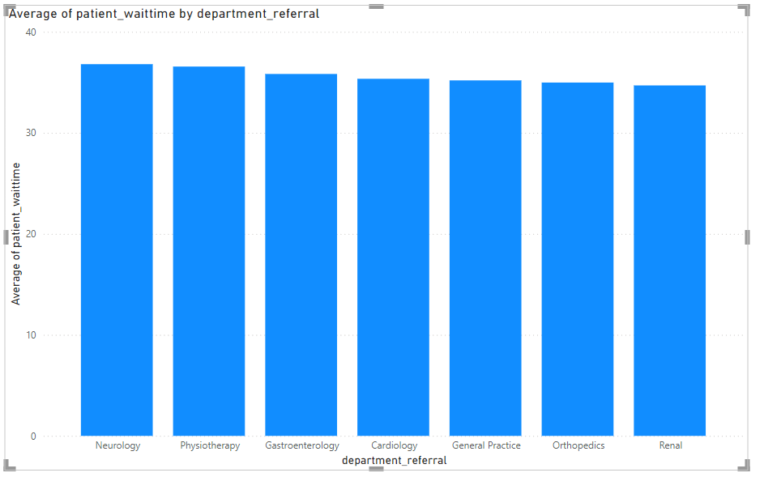
Insights & Recommendations
Proposed Departments For Additional Doctors
Departments that consistently handle a large number of patients or have long wait times due to high demand should be prioritized.
Here, they are Neurology and Physiotherapy.

Slide 19
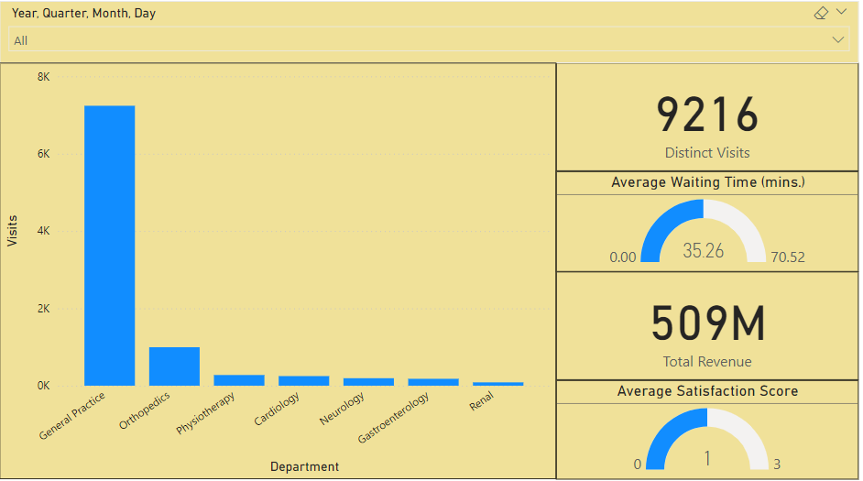
Dashboards
Main Tab
Using the Main tab, the hospital may look at overall metrics like number of daily visits, revenue produced on that day, customer satisfaction, how busy different departments are on that day and general waiting time on that day. This tab includes a slicer for date.

Slide 20
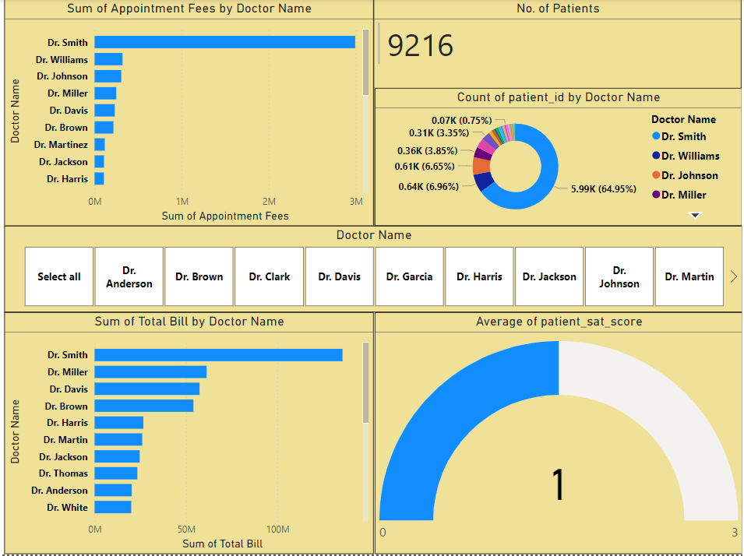
Dashboards
Doctor’s Tab
Using the Doctors’ Tab, the Chief Of Staff may look at individual doctors’ performance metrics like customer satisfaction, number of patients he/she was visited by, revenue he/she has generated and appointment fees. This tab includes a slicer for Doctor Name.

Slide 21
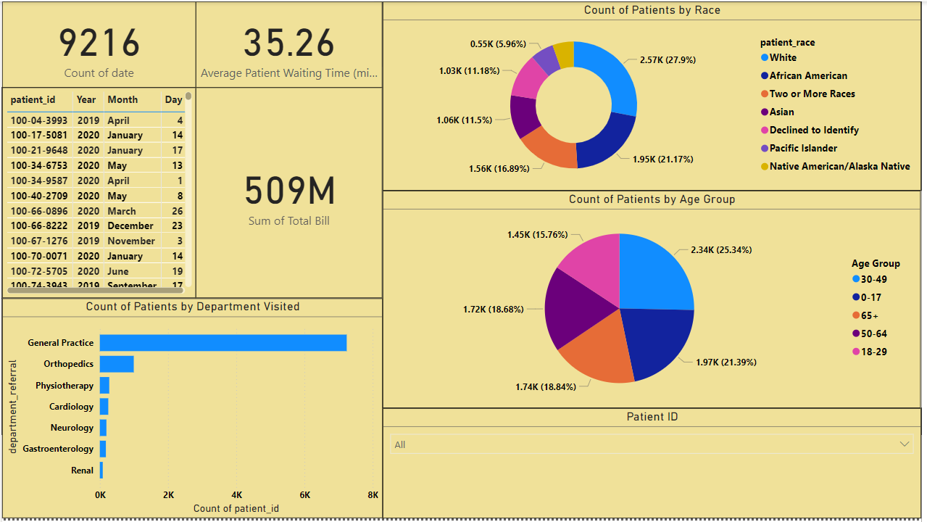
Dashboards
Patients’ Tab
Using the Patients’ Tab, the Patient’s Care Chief may look at a patient profile involving metrics like most frequently visited department, age, race, waiting time, number of visits, total amount paid to the hospital, etc. This tab includes a slicer for Patient ID.

